Slide 1
IBM University Engagement Project Submission
“Exploring the Power of Agentic AI with IBM Granite and LangFlow”

Slide 2

Project Tile – AI agent for chronic disease monitoring
Domain of Project –Healthcare
Student Name | Recent Passport Photo | Email ID | Mobile number [WhatsApp]
Gaurao Hage |  | hagegaurav950@gmail.com | 7507320954

Slide 3
Problem Statement No. 27 – AI-Powered Chronic Disease Monitoring Agent
The Challenge
Chronic diseases such as diabetes, hypertension, and heart conditions require continuous monitoring, proper medication adherence, and lifestyle management. However, patients often struggle to track their health conditions, understand medical reports, monitor vital signs, and identify early warning symptoms. Healthcare providers may not always have access to real-time patient health data, making it difficult to provide timely interventions.
Without personalized AI-driven monitoring, predictive insights, and early health alerts, patients may experience complications, delayed treatment, and frequent hospital visits.
Objective
Build an AI-powered Chronic Disease Monitoring Agent that continuously analyzes patient health data and provides personalized insights, early risk detection, and preventive healthcare recommendations.
The solution should:
Personalized Health Monitoring – Track patient health based on medical history and health conditions.
Health Data Analysis – Analyze data from wearables, medical records, glucose monitors, and blood pressure monitors.
AI-Based Risk Prediction – Identify abnormal patterns and predict potential health risks.
Real-Time Alerts – Notify patients and healthcare providers about critical health changes.
Medication Reminders – Help patients follow prescribed medication schedules.
Preventive Health Recommendations – Suggest personalized diet, exercise, and lifestyle improvements.
Multi-Agent System – Integrate Health Monitoring, Risk Prediction, Medication Management, Health Advisory, and Alert & Notification Agents.
Visualization Dashboard – Display health trends, vital signs, medication adherence, risk levels, and patient progress.

Slide 4
Proposed Solution: AI-Powered Chronic Disease Monitoring Agent
The proposed solution is a multi-agent AI-powered Chronic Disease Monitoring Agent built using LangFlow, IBM watsonx.ai, and IBM Granite Models to provide continuous health monitoring, early risk detection, and personalized healthcare recommendations.
At its core, the system uses a Retrieval-Augmented Generation (RAG) pipeline to retrieve reliable medical information from trusted sources such as WHO and verified healthcare repositories, enabling accurate health insights and recommendations.
The system consists of five key agents:
Health Monitoring Agent – Collects and analyzes patient health data, including blood glucose, blood pressure, heart rate, and medical history.
Risk Prediction Agent – Identifies abnormal health patterns and potential risks associated with diabetes, hypertension, and heart conditions.
Medication Management Agent – Sends medication reminders and tracks adherence to prescribed schedules.
Health Advisory Agent – Provides personalized diet, exercise, sleep, and lifestyle recommendations.
Alert & Notification Agent – Generates real-time alerts and notifies patients or healthcare providers about potential health risks.
A user-friendly dashboard (Streamlit/React) visualizes health trends, vital signs, medication adherence, risk indicators, and overall health progress.
LangFlow orchestrates multi-agent workflows, IBM watsonx.ai provides AI integration and deployment, and IBM Granite Models power intelligent analysis, reasoning, and personalized recommendations.
Overall, the solution promotes proactive healthcare, early risk identification, and improved chronic disease management.

Slide 5
Technology Used
LangFlow Platform – For visually designing and orchestrating multi-agent workflows.
IBM Granite Models – (e.g., ibm-granite-3-2-8b) For natural language understanding, reasoning, health data analysis, and personalized recommendations.
IBM Cloud – Provides secure, reliable, and scalable infrastructure to build, deploy, and run the Chronic Disease Monitoring Agent.
RAG (Retrieval-Augmented Generation) – Retrieves information from trusted medical sources before generating AI-powered health insights and recommendations.
IBM watsonx.ai – For AI model deployment, embeddings, model integration, and AI governance.
Vector Database (FAISS/Chroma) – For storing and retrieving medical knowledge and healthcare information efficiently.
Streamlit / React – For developing an interactive dashboard to visualize patient health data, trends, alerts, and monitoring reports.
Python – For backend development, data processing, agent integration, and health monitoring logic.

Slide 6
LangFlow Components Used
1) Chat Input – Interface where patients enter health-related queries, symptoms, medical details, and health readings.
2) IBM watsonx AI Agent – Processes patient inputs using IBM Granite models to generate personalized health insights and recommendations.
3) IBM Granite Model – granite-4.0-8b-instruct → Used for natural language understanding, reasoning, health data analysis, and personalized recommendations.
4) Chat Output – Displays AI-generated responses, health insights, risk assessments, medication guidance, and preventive suggestions.
5) File Component – Stores and retrieves medical documents, patient records, health reports, and medical knowledge datasets.
6) Prompt Template – Defines instructions and context for the AI agent to generate relevant and structured healthcare responses.
7) Vector Store / Database – Stores medical knowledge embeddings and enables RAG-based retrieval of relevant healthcare information.
8) Retriever Component – Fetches relevant medical information from the vector database to support accurate AI responses.
9) Text Splitter – Divides medical documents into smaller chunks before embedding and storing them.
10) Embedding Model – Converts medical text into vector representations for semantic search and information retrieval.
11) Conditional Router – Routes patient queries to appropriate agents, such as Health Monitoring, Risk Prediction, Medication Management, and Health Advisory.
12) API Request Component – Connects external services or health data sources to retrieve patient monitoring information.

Slide 7
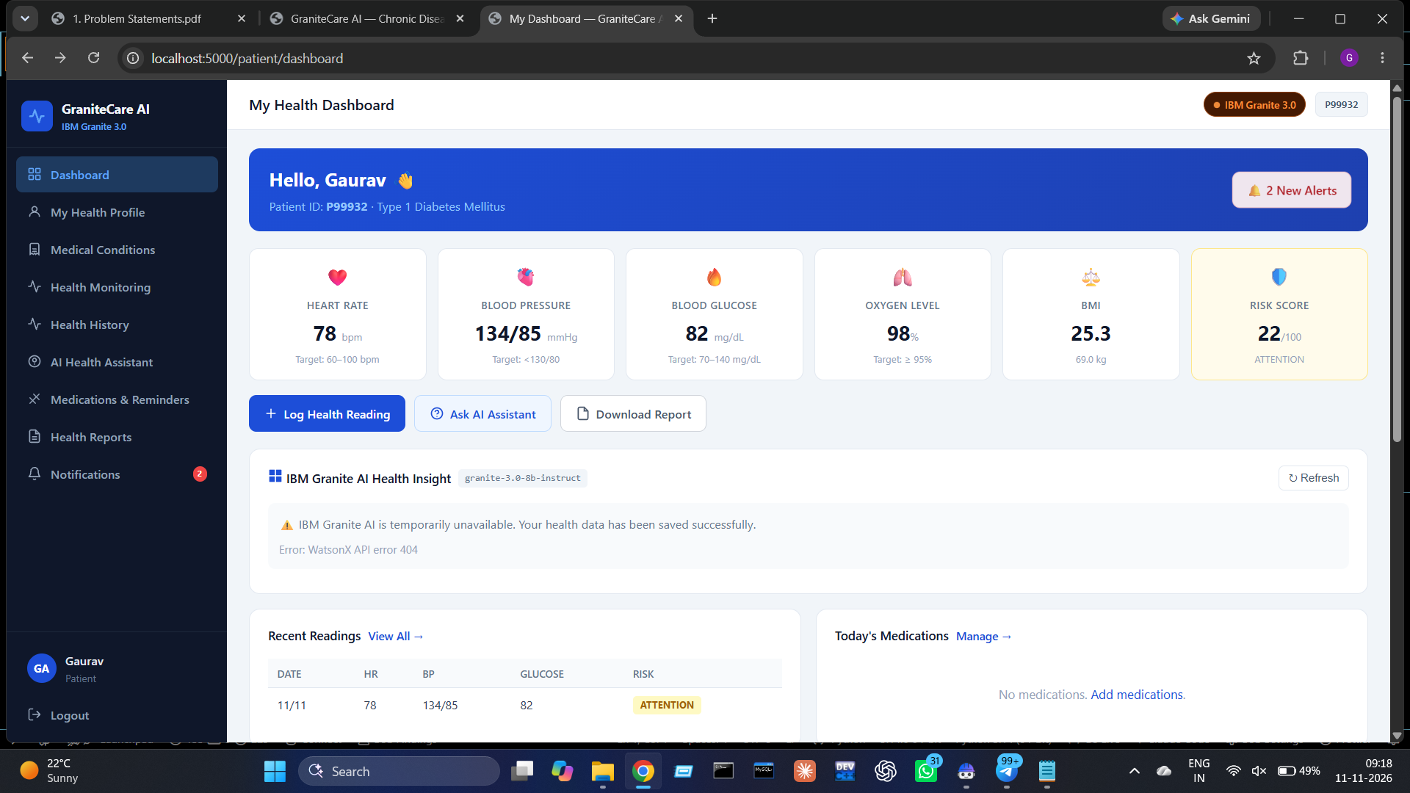

Slide 8
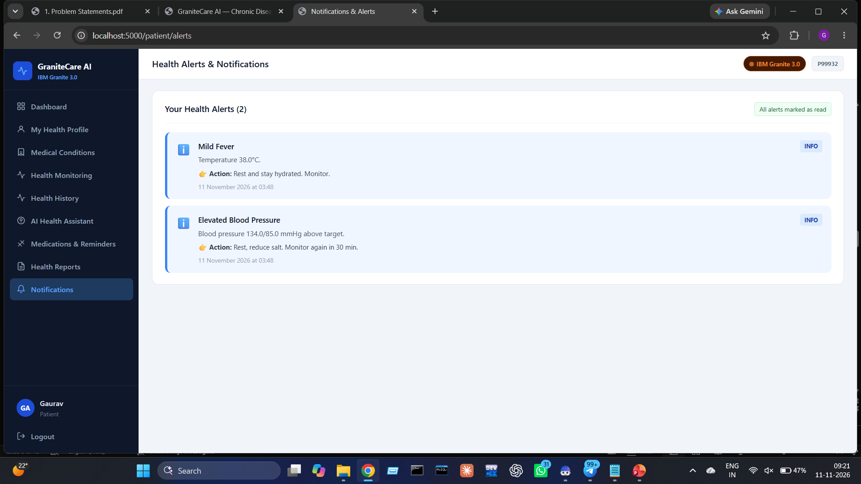

Slide 9
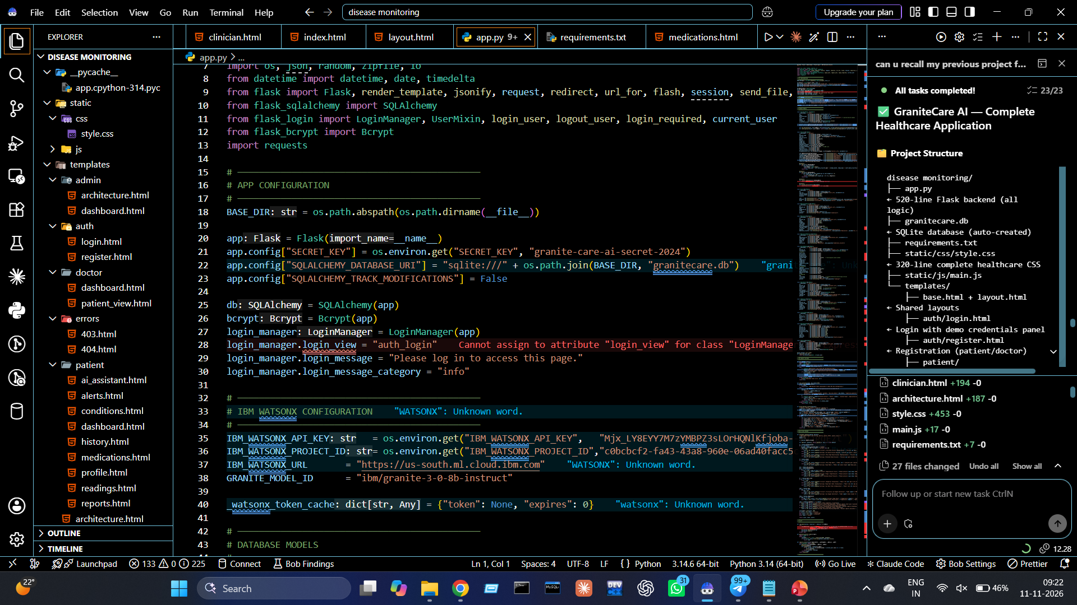

Slide 10
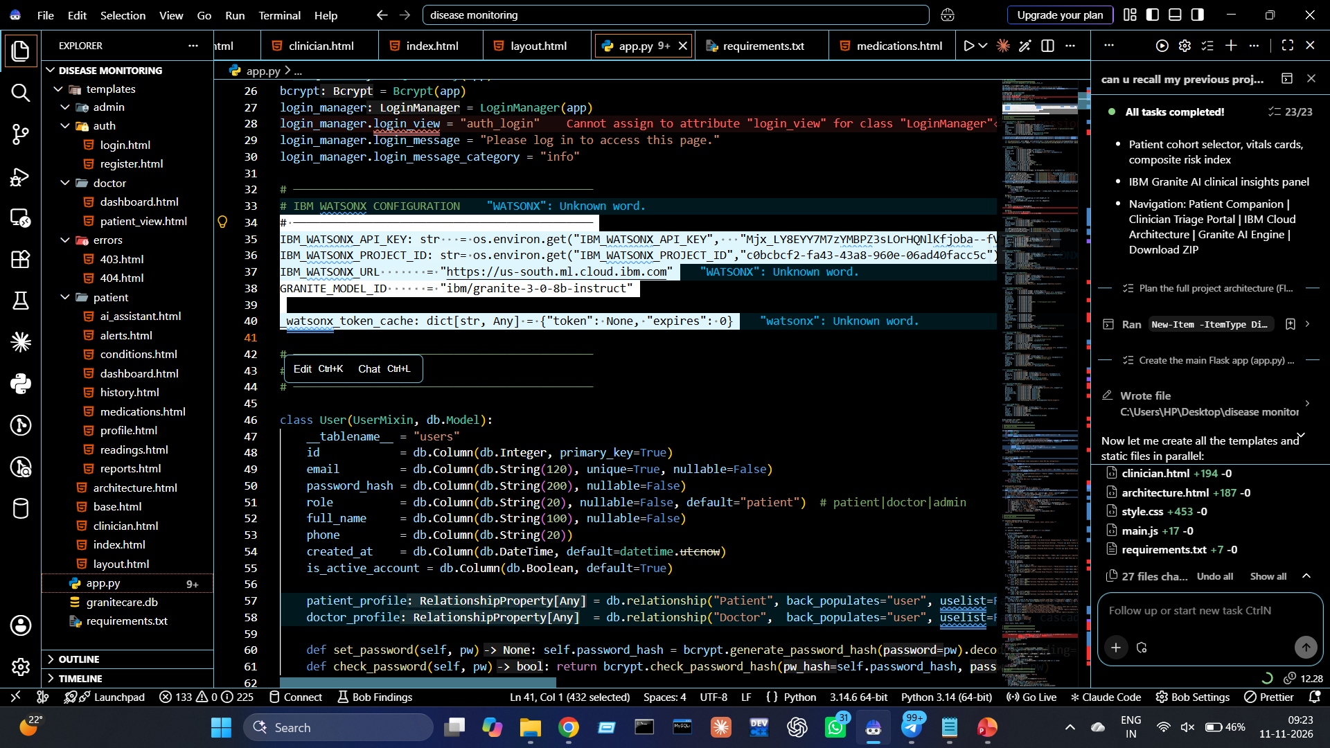

Slide 11

Role of Agentic AI in Chronic Disease Monitoring Agent
Agentic AI enables the Chronic Disease Monitoring Agent to function as an intelligent, proactive system rather than a simple chatbot. Using IBM watsonx.ai and IBM Granite models, it coordinates multiple specialized agents to support continuous health monitoring and personalized care.
Each agent performs a specific role—such as monitoring vital signs, analyzing health data, predicting potential risks, managing medication reminders, and providing lifestyle recommendations—while working collaboratively. This multi-agent approach enables efficient task execution and coordinated health support.
Agentic AI also provides context awareness by considering patient details such as age, medical history, existing health conditions, and previous health readings to generate personalized insights.
It supports real-time adaptation, updating its analysis and recommendations as new information is received from wearables, medical records, and patient inputs. When abnormal patterns or potential health risks are detected, the system can generate alerts for patients and healthcare providers.
Additionally, agents communicate with each other to combine health information, improve decision-making, and support proactive monitoring.
Overall, Agentic AI makes the system proactive, personalized, and goal-driven, acting as an intelligent digital health assistant that supports patients in managing chronic conditions such as diabetes, hypertension, and heart disease.

Slide 12
Novelty and Uniqueness
The proposed Chronic Disease Monitoring Agent stands out by combining Agentic AI, RAG, predictive analytics, and personalized healthcare into a single intelligent system.
Multi-Agent Intelligence – Multiple specialized agents collaborate to monitor health, assess potential risks, manage medication reminders, and provide personalized recommendations.
RAG-Based Medical Knowledge – Retrieves relevant information from trusted medical sources before generating AI responses, helping provide context-aware and evidence-informed guidance.
Personalized Health Monitoring – Tailors insights based on medical history, age, health conditions, vital signs, and individual health goals.
Predictive Risk Detection – Analyzes health trends and abnormal patterns to identify potential warning signs at an early stage.
Real-Time Monitoring & Alerts – Responds to new health readings and alerts patients or healthcare providers when readings require attention.
Continuous Feedback Loop – Adapts health insights as new readings, symptoms, and patient updates become available.
Integrated Chronic Care Support – Combines health tracking, medication reminders, lifestyle guidance, and risk monitoring in one platform.
IBM-Powered Architecture – Built using IBM watsonx.ai, IBM Granite models, and LangFlow to support intelligent workflows and scalable AI integration.
This makes the solution a smart, adaptive, and proactive digital health assistant, going beyond basic health tracking to support continuous chronic disease management.

Slide 13
Git Hub Link
https://github.com/gauravhage05/AI-disease-monitoring.git
·
·
·

Slide 14
Future Scope
1. Integration with Wearables & Health Devices –
The system can be integrated with smartwatches, glucose monitors, and blood pressure monitors to collect real-time health data such as heart rate, blood glucose levels, blood pressure, and oxygen saturation. This will enable continuous monitoring and timely detection of abnormal health patterns.
2. AI-Powered Voice Assistant & Multilingual Support –
Enhancing the system with a voice-enabled assistant and support for multiple languages will improve accessibility. Patients can interact naturally in their preferred language, making the solution more inclusive, especially for people in rural areas and regions with diverse linguistic backgrounds.
3. Advanced Predictive Analytics –
Future versions can use historical health records and machine learning models to identify patterns and estimate the risk of potential health complications, supporting early medical intervention.
4. Healthcare Provider Integration –
The system can be connected with hospital systems and healthcare professionals to share patient health reports, monitoring summaries, and alerts, enabling better coordination between patients and doctors.
5. Personalized Treatment Adherence Support –
Future enhancements can include prescription schedule tracking, refill reminders, and follow-up notifications to help patients follow their healthcare plans.
6. Secure Cloud-Based Health Records –
Integration with secure cloud infrastructure can enable patients to access their health records and monitoring history from different devices while maintaining privacy and data security.
·
·
·

Slide 15
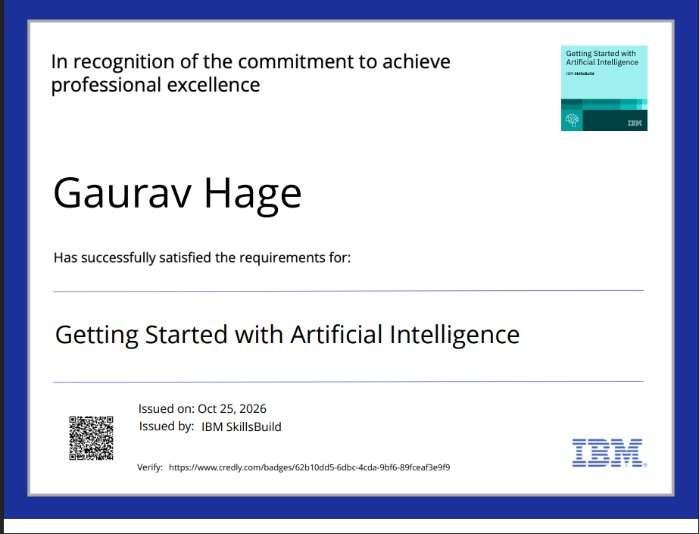
Certificates Earned:

Slide 16
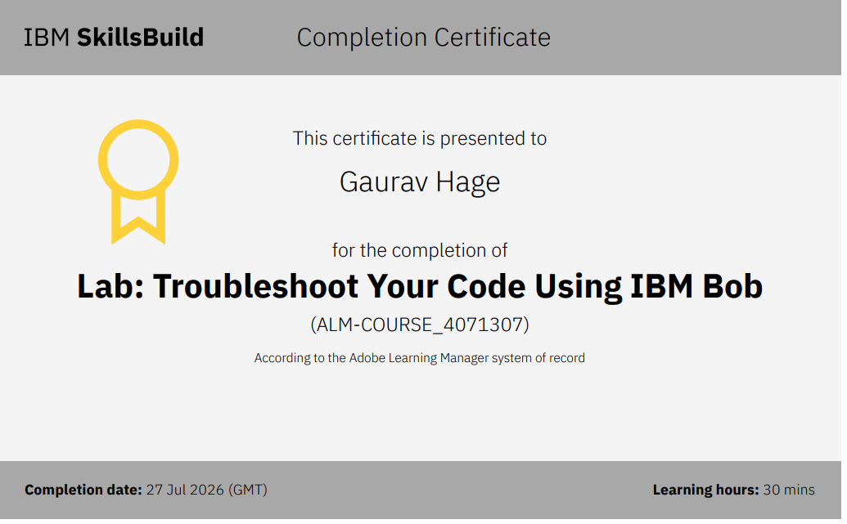
Certificates Earned:​

Slide 17


